Slide 1
Reporting uterine fibroid in ultrasound examination
Reporting uterine fibroid in ultrasound examination: a proposal and pictorial guide focused on surgical planning.
AUTORES
Michel Santos Palheta
Ana Roberta Gomes Severiano
Akidauanna Sales Bezerra Soares
Alice Mariel Barbosa de Araújo
Carlos Argemiro Vasques Rolim
Danilo Escócio de Souza

Slide 2
1. INTRODUCTION
Uterine fibroids are the most common benign gynecologic tumors in women of reproductive age and ultrasound is the first-line imaging modality for the diagnosis and characterization of these uterine fibroids. The classification of the International Federation of Gynecology and Obstetrics (FIGO) was developed to describe and classify uterine fibroids more uniformly and consistently. The correct description of fibroids in the ultrasound report is essential for planning surgical treatment and preventing complications. In this pictorial essay, we review the sonographic findings of fibroids, detailing the main key points to be reported for pre-surgical evaluation. In addition, we present a structured and illustrated report template to describe fibroids based on the critical points of surgical planning.
2. OBJECTIVE
To illustrate the main findings to be reported in the ultrasound report and, additionally, to propose a structured report of transvaginal ultrasounds for pre-surgical evaluation of patients with uterine fibroids.

Slide 3
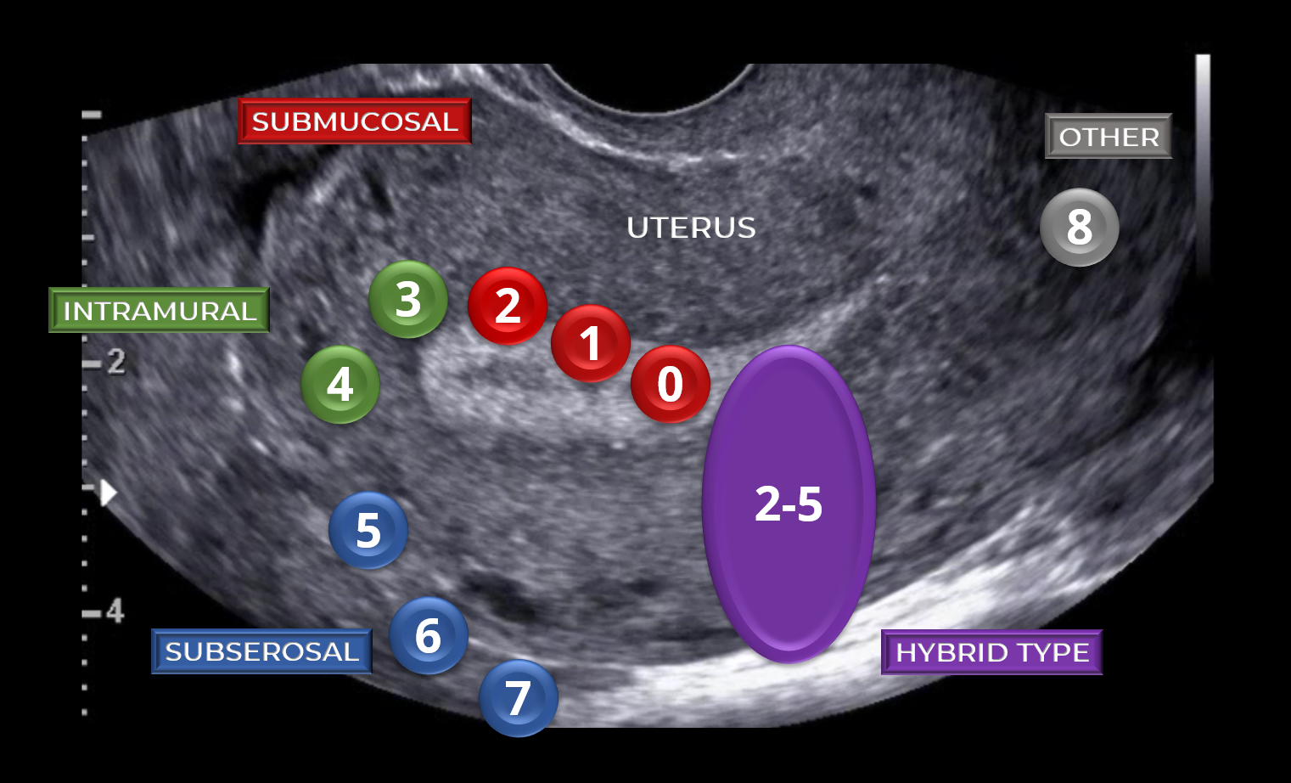
3. Description of Images, Comments and/or Discussion
a) FIGO classification of fibroids
Localization | Type | Description
Submucosal | 0 | Pedunculated intracavitary fibroid (i.e., submucosal without intramural extension).
 | 1 | Submucous fibroid with intramural extension less than 50%.
 | 2 | Submucous fibroid with intramural extension greater than 50%.
Intramural | 3 | Intramural fibroid in contact with the endometrium, but not extending into the uterine cavity or serous surface
 | 4 | Intramural fibroid without contact with the endometrium, and without extension into the uterine cavity or serous surface.
Subserosal | 5 | Subserosal fibroid with intramural extension greater than 50% and less than 50% is subserosal.
 | 6 | Subserosal fibroid with intramural extension less than 50% and more than 50% is subserosal.
 | 7 | Subserosal pedunculated fibroid.
Other | 8 | Other types of fibroids (e.g., cervical, broad ligament, parasitic).
Hybrid type | 2–5 | Hybrid classification is used when a fibroid extends from the endometrial cavity to the serosa. Two numbers are listed, separated by a hyphen. The first number is used to characterize the relationship between the fibroid and the endometrium, the second with the serosa.
FIGO classification of fibroids, fibroid types: 0 = pedunculated intracavitary; 1 = submucosal, < 50% intramural; 2 = submucosal, ≥ 50% intramural; 3 = 100% intramural, but in contact with the endometrium; 4 = intramural; 5 = subserosal, ≥ 50% intramural; 6 = subserosal, < 50% intramural; 7 = subserosal pedunculated; 8 = other (e.g., cervical, parasitic) and hybrid type [2–5] being submucosal combined with subserosal with less than 50% indentation in cavity as well as serosal surface.⁸

Slide 4
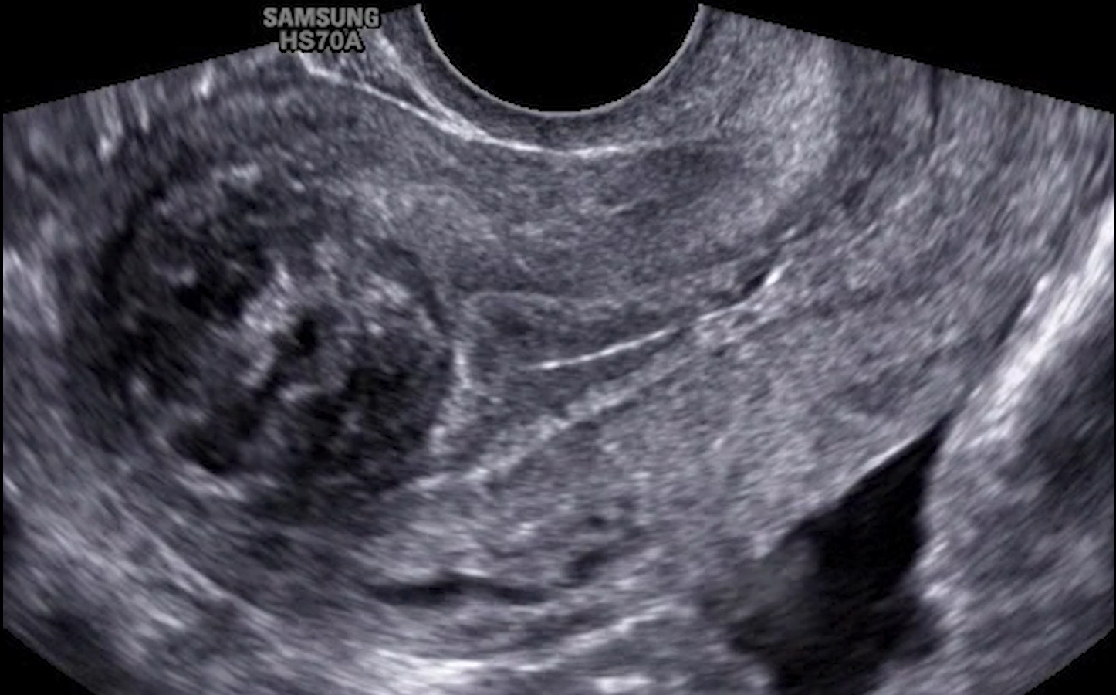
b) Ultrasound diagnosis of uterine fibroids
Classically, ultrasound imaging of uterine fibroids is characterized as a solid, rounded, well-defined hypoechoic, heterogeneous lesion within the myometrium, often showing shadows at the edge of the lesion and/or an internal fan-shaped shadow
Figure 1. Transvaginal ultrasound image showing a submucosal uterine fibroid

Slide 5
c) Ultrasound color Doppler of uterine fibroids
On color Doppler, the circumferential flow around the lesion is often visible (Figure 2). In addition to revealing the vascularity of fibroids, a study by Fleischer and his colleagues demonstrated that hypervascular fibroids on color Doppler ultrasound have more reduction in size than isovascular or hypovascular fibroids after uterine artery embolization, And postprocedure sonographic imaging showed decreased uterine size and echogenicity and Color Doppler imaging showed a marked decrease in the blood flow to the leiomyoma.
Figure 2. Transvaginal color Doppler ultrasound image showing a submucosal fibroid with circumferential vascularity.

Slide 6
d) Consensus from the Morphological Uterus Sonographic Assessment (MUSA)
Parameters | Criteria
Uterus | Measurement of length, anteroposterior diameter, transverse diameter and volume
Serosal contour | Regular or lobulated
Myometrial walls | Symmetrical or asymmetrical
Myometrial echogenicity | Homogeneous or heterogeneous
Myometrial lesions | Margin | Well-defined or ill-defined
 | Number of lesions
 | Location | Anterior , posterior, fundal, right or left lateral, or global
 | Type | According to FIGO classification
 | Size | Three perpendicular diameters
 | Outer lesion-free margin | Distance from the serosal surface
 | Inner lesion-free margin | Distance from the endometrial surface
 | Echogenicity | Hypoechogenic, isoechogenic or hyperechogenic.

Slide 7
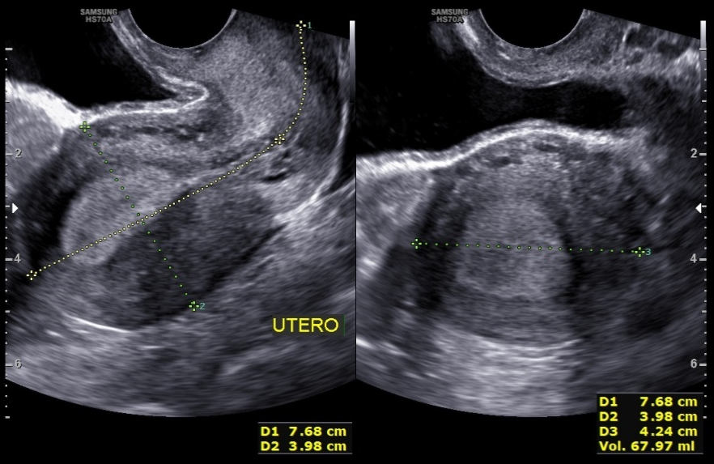
e) Key points for the surgical treatment of fibroids
e.1) Uterine volume
It is recommended to measure the uterus in its longitudinal, anteroposterior and transverse diameters, as this provides the uterine volume in cm³, which is extremely useful in surgical planning (Figure 3). As the due diligence of transvaginal ultrasound becomes significantly less than MRI at volumes >375 ml.
e.2) Number
The description of the number of fibroids will determine whether fibroid resection is feasible for symptom control. When numerous, consider reporting a range of 10 to 20. Although it is not necessary to describe all lesions, a minimum number should be chosen²⁷. Most publications have suggested the description of up to four non-submucous fibroids and all submucous fibroids.
Figure 3. Transvaginal ultrasound image in transverse and longitudinal sections showing the measurement of the uterus.

Slide 8
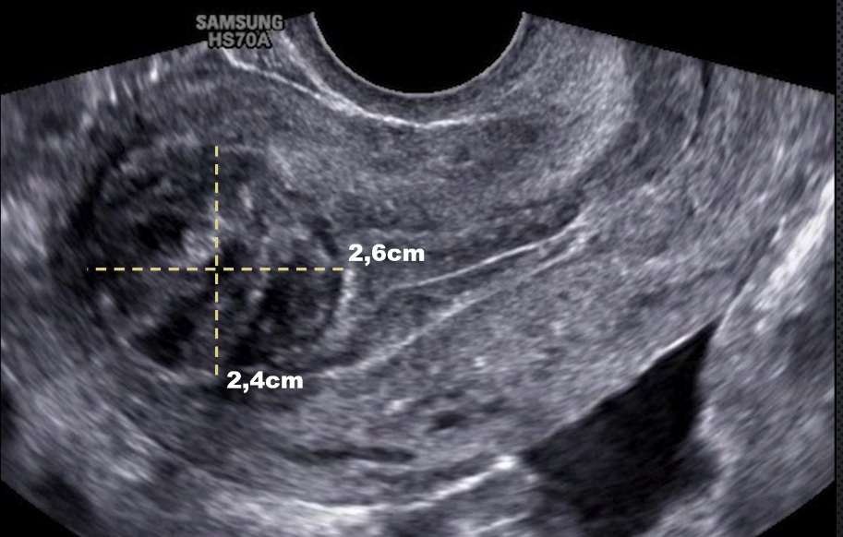
e.3) Size
It is recommended that each fibroid described in the report be systematically measured in three orthogonal planes, to obtain the volume of the nodule in cm³. the size of the fibroids helps the gynecologist to estimate the probability that fibroids are the direct cause of the patient’s symptoms and determine the best surgical approach (Figure 4).
e.4) Location
It is essential to registry the location of the nodule on the anterior, posterior, right or left lateral wall, uterine fundus or global. For example, when the fibroid is located on the lateral wall or in the uterine fundus, there is a greater degree of complexity in the hysteroscopic surgical technique .
Figure 4. Transvaginal ultrasound image in longitudinal section showing the fibroid with recorded dimensions.

Slide 9
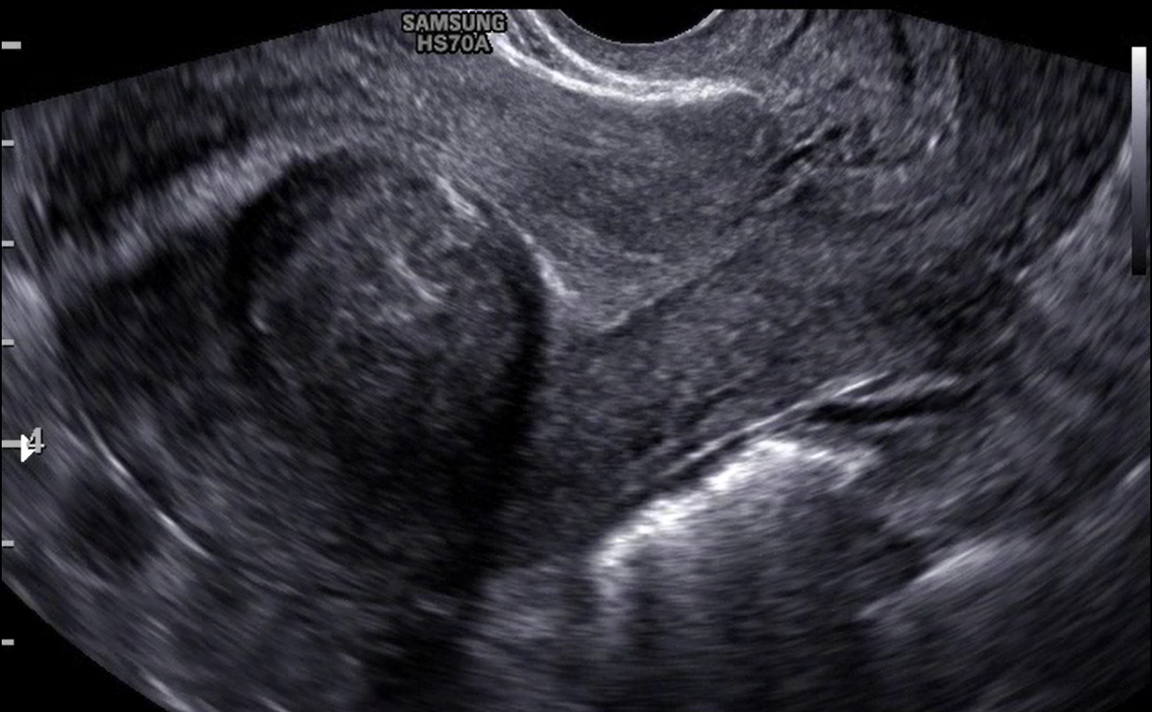
e.5) Type of fibroid based on FIGO classification
Submucous fibroids (FIGO 0, FIGO 1 and FIGO 2) are a frequent cause of menorrhagia and dysmenorrhea, as they project into the endometrial cavity. For women with a desire for pregnancy, submucous fibroids can also be a cause of infertility or miscarriage³⁰. Due to this, submucous fibroids require surgical treatment, regardless of size. Treatment often includes hysteroscopic resection. Occasionally, hysterectomy may be an option for symptomatic patients with no reproductive desire. Hysteroscopic myomectomy of a bulky FIGO 2 fibroid can be difficult and may require a two-step surgery or uterine artery embolization (Figure 5).
fibroid
Figure 5. Transvaginal ultrasound image in longitudinal section showing the submucous fibroid (FIGO 2) with an intramural component greater than 50%.

Slide 10
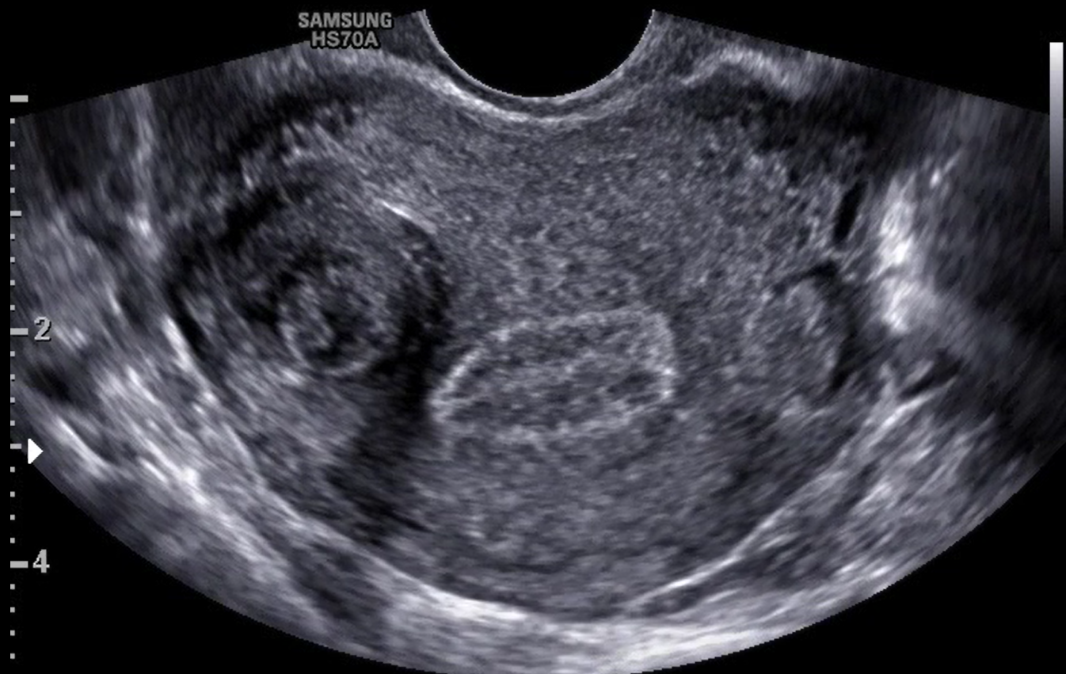
e.6) Myometrial mantle
This parameter can be measured on transvaginal ultrasound, as several authors consider the outer myometrial mantle (distance from the fibroid margin to the serous surface) and the inner myometrial mantle (distance from the fibroid margin to the endometrial surface) to be key factors for hysteroscopic resection of submucous fibroids. Furthermore, in FIGO 2 fibroids when the outer myometrial mantle is smaller than 0.5 cm, some studies suggest a greater chance of uterine rupture during resection (Figure 6).
fibroid
Figure 6. Transvaginal ultrasound image in cross-section showing the intramural fibroid (FIGO 4) with the measurement of the outer mantle (distance from the serous surface) and inner mantle (distance from the endometrial surface) (white lines).

Slide 11
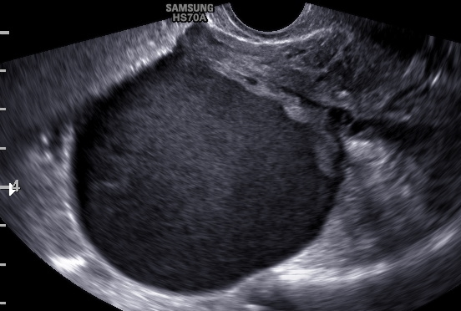
e.7) Presence of adenomyosis
e.8) Presence of endometriosis
Figure 7. Transvaginal ultrasound image showing retroverted uterus infiltration of the posterior wall by adenomyosis (white arrow).
Figure 8. Transvaginal ultrasound image showing ovarian endometrioma.

Slide 12
f) Proposal of a structured ultrasound report for preoperative evaluation of patients with fibroids
Fibroids Imaging Reporting for Surgical Treatment (FIRST)
EXAM INDICATION: |  | Asymptomatic patient ( )
 |  | Evaluation of a clinical finding: |  |  | Pelvic pain ( ) Menorrhagia ( ) Infertility ( )
 |  | Fibroid follow-up ( )
 |  | Follow-up after operative fibroid treatment ( )
TECHNIQUE: Examination performed with a device (model/manufacturer) with convex (abdominal) and endocavitary (transvaginal) transducers and the patient with/without bowel preparation.
FINDINGS
MIDDLE PELVIC COMPARTMENT
UTERUS: in (anteversion/retroversion) position, with regular outer contours, myometrium with preserved echotexture, except in the areas of myometrial nodules and normal mobility (Positive sliding sign). Uterine biometry: _ x _ x _ cm (volume: _ cm³).
Note the presence of solid, hypoechoic and heterogeneous nodular images, with regular contours and well-defined limits, compatible with fibroids. The table below shows the main aspects:
Fibroid | FIGO Classification |  | Dimensions (cm) | Localization |  | Inner mantle | Outer mantle
1
2
3
4
5
6
ENDOMETRIUM: centered / displaced, of uniform echogenicity, trilaminar / echogenic pattern, measuring _mm thick. Junctional zone: (regular / irregular).
RIGHT OVARY: parauterine, with normal contours and echotexture, normal mobility. measuring __x __x __cm (vol = cm³).
LEFT OVARY: parauterine, with normal contours and echotexture, normal mobility. measuring __x __x __cm (vol = cm³).
Report of painful sensitivity on mobilization with a transducer |  | Yes ( )
 |  | No ( )
ANTERIOR PELVIC COMPARTMENT:
Bladder: with good repletion, thin and regular walls, with homogeneous anechoic content. There was no evidence of endometriosis lesion in the bladder. In the search for adhesions with the mobility of the transducer, it showed mobility and anatomical sliding of the vesical wall with the anterior wall of the uterus (+ sliding sign).
POSTERIOR PELVIC COMPARTMENT:
There is no evidence of endometriosis foci in the retrocervical region and uterosacral ligaments.
There are no evident signs of thickening or nodules in the intestinal loops and rectum detectable without bowel preparation.
Signs of adenomyosis: | ( ) Absent
 | ( ) Focal
 | ( ) Diffuse

Slide 13
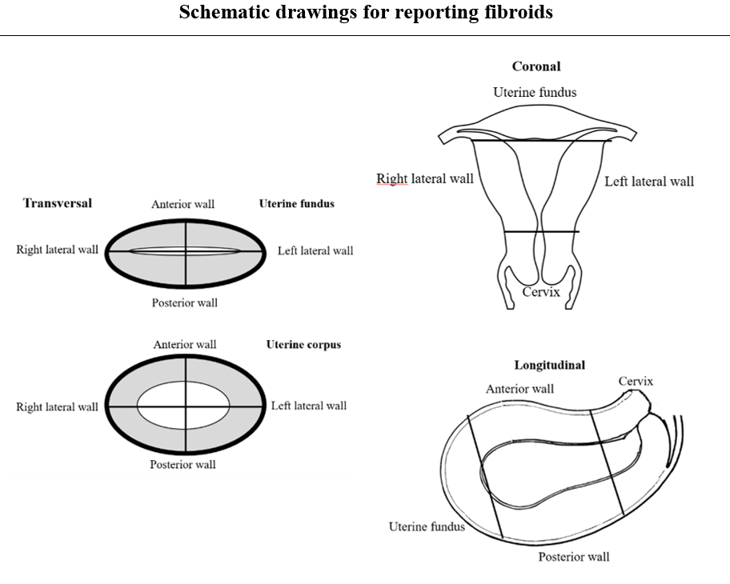
f) Proposal of a structured ultrasound report for preoperative evaluation of patients with fibroids
CONCLUSIONS OF FINDINGS:
- Myometrial nodule(s) compatible with fibroid(s), type 0/1/2/3/4/5/6/7/8 (FIGO Classification) - Number of fibroids: __ - Number of fibroids with submucosal component:__ - Number of fibroids without submucosal component:__ - Mass effect on the endometrial cavity ( ) Yes ( )No - Presence of submucous fibroid in the uterine fundus ( ) Yes ( )No - Presence of submucous fibroid in the lateral wall ( ) Yes ( )No - Focal / diffuse adenomyosis - Ovaries with normal ultrasound findings; - Ovarian reserve: Normal ( ) Low ( ) - Endometrioma in the right / left ovary; - Adhesive processes in the vesicouterine pouch / uterine rectum pouch; - Anterior pelvic compartment with deep endometriosis, endometriosis mapping exam with bowel preparation is recommended. - Posterior pelvic compartment with deep endometriosis, endometriosis mapping exam with bowel preparation is recommended.

Slide 14
5. CONCLUSION
There are key points in the characterization of fibroids that help gynecologists in planning surgical treatment and have the potential to avoid possible complications and treatment failure. The proposal of a structured and illustrated report model to describe fibroids based on these critical points can improve patient counseling and treatment planning, including the selection of the most appropriate medical or surgical therapeutic strategy.

Slide 15
TRANSVAGINAL ULTRASOUND OF SUBMUCOSAL FIBROIDS
6. REFERENCES
1. Munro MG, Critchley HO, Broder MS, Fraser IS, Disorders FWGoM. FIGO classification system (PALM-COEIN) for causes of abnormal uterine bleeding in nongravid women of reproductive age. Int J Gynaecol Obstet. 2011;113(1):3-13.
2. Frascà C, Tuzzato G, Arena A, Degli Esposti E, Zanello M, Raimondo D, Seracchioli R. The Role of Pelvic Ultrasound in Preoperative Evaluation for Laparoscopic Myomectomy. J Minim Invasive Gynecol. 2018 May-Jun;25(4):679-683.
3. Van den Bosch T, Dueholm M, Leone FP, Valentin L, Rasmussen CK, Votino A, Van Schoubroeck D, Landolfo C, Installé AJ, Guerriero S, Exacoustos C, Gordts S, Benacerraf B, D'Hooghe T, De Moor B, Brölmann H, Goldstein S, Epstein E, Bourne T, Timmerman D. Terms, definitions and measurements to describe sonographic features of myometrium and uterine masses: a consensus opinion from the Morphological Uterus Sonographic Assessment (MUSA) group. Ultrasound Obstet Gynecol. 2015 Sep;46(3):284-98.
4. Sabre A, Serventi L, Nuritdinova D, Schiattarella A, Sisti G. Abnormal uterine bleeding types according to the PALM-COEIN FIGO classification in a medically underserved American community. J Turk Ger Gynecol Assoc. 2021 May 28;22(2):91-96.
5. Harmsen MJ, Van den Bosch T, de Leeuw RA, Dueholm M, Exacoustos C, Valentin L, Hehenkamp W, Groenman F, De Bruyn C, Rasmussen C, Lazzeri L, Jokubkiene L, Jurkovic D, Naftalin J, Tellum T, Bourne T, Timmerman D, Huirne JAF. Consensus on revised definitions of morphological uterus sonographic assessment (MUSA) features of adenomyosis: results of a modified Delphi procedure. Ultrasound Obstet Gynecol. 2021 Sep 29.
6. Barbosa PA, Villaescusa M, Andres MP, Fernandes LFC, Abrão MS. How to minimize bleeding in laparoscopic myomectomy. Curr Opin Obstet Gynecol. 2021 Aug 1;33(4):255-261.
7. Shubham D, Kawthalkar AS. Critical evaluation of the PALM-COEIN classification system among women with abnormal uterine bleeding in low-resource settings. Int J Gynaecol Obstet. 2018 May;141(2):217-221.
8. Bajaj S, Gopal N, Clingan MJ, Bhatt S. A pictorial review of ultrasonography of the FIGO classification for uterine leiomyomas. Abdom Radiol (NY). 2022 Jan;47(1):341-351.
9. Piessens S, Edwards A. Sonographic Evaluation for Endometriosis in Routine Pelvic Ultrasound. J Minim Invasive Gynecol. 2020 Feb;27(2):265-266.

